Slide 1

Ziming Li
SFIV with DQN
2022-5-20

Slide 2
SFIV with DQN
Ziming Li
SFIV with DQN
2022-5-20

Slide 3
Introduction
1. DQN算法简介
2. 训练过程
3. 项目结构介绍
4. 代码细节介绍
5. 效果展示
6. 问题简述
Ziming Li
SFIV with DQN
2022-5-20 1/23

Slide 4
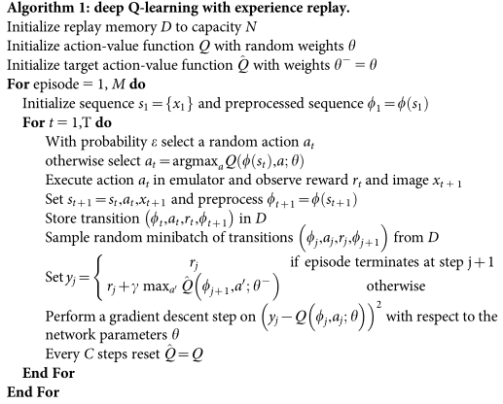
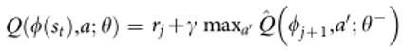
DQN's Algorithm description
1. 玩游戏时通过replay memory存放游戏状态记录(transition);
2. 存在两个神经网络，分别是Q以及Q'，这两个神经网络结构一样，而：
(1) Q是较新的一个神经网络，总能从最新的transition中学到最新的特征，并且能根据当前的status输出奖励最大的action，每经过N step会对Q进行更新；
(2) Q'是落后于Q M个step的神经网络;
(3) Q'的作用是让训练过程保持稳定；
(4) 每经过C step，将Q复制给Q'；
Ziming Li
SFIV with DQN
2022-5-20 2/23

Slide 5
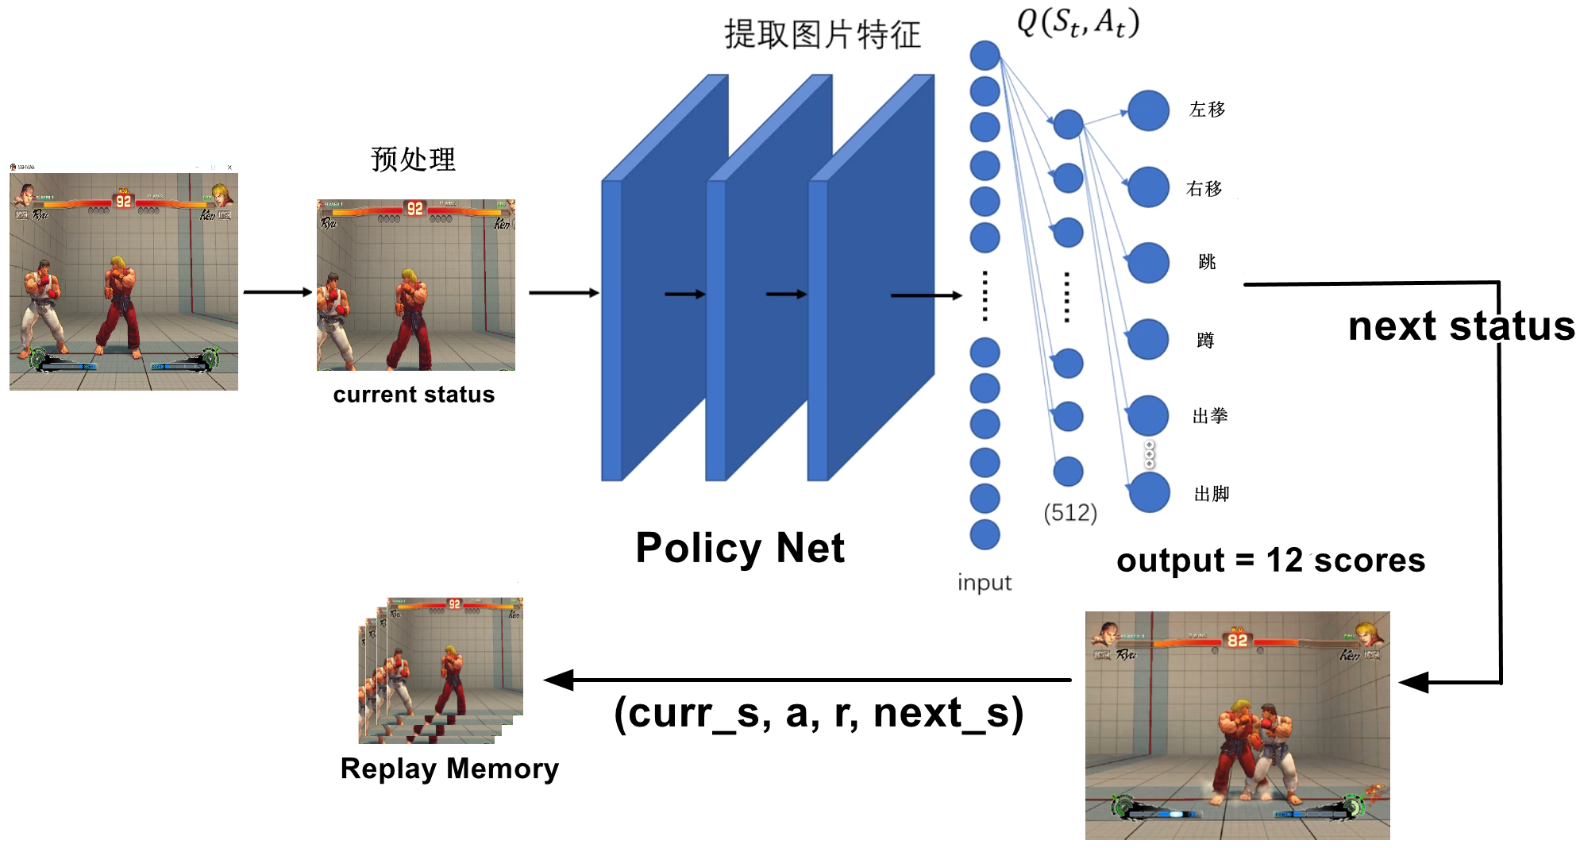
Training process
Ziming Li
SFIV with DQN
2022-5-20 3/23

Slide 6
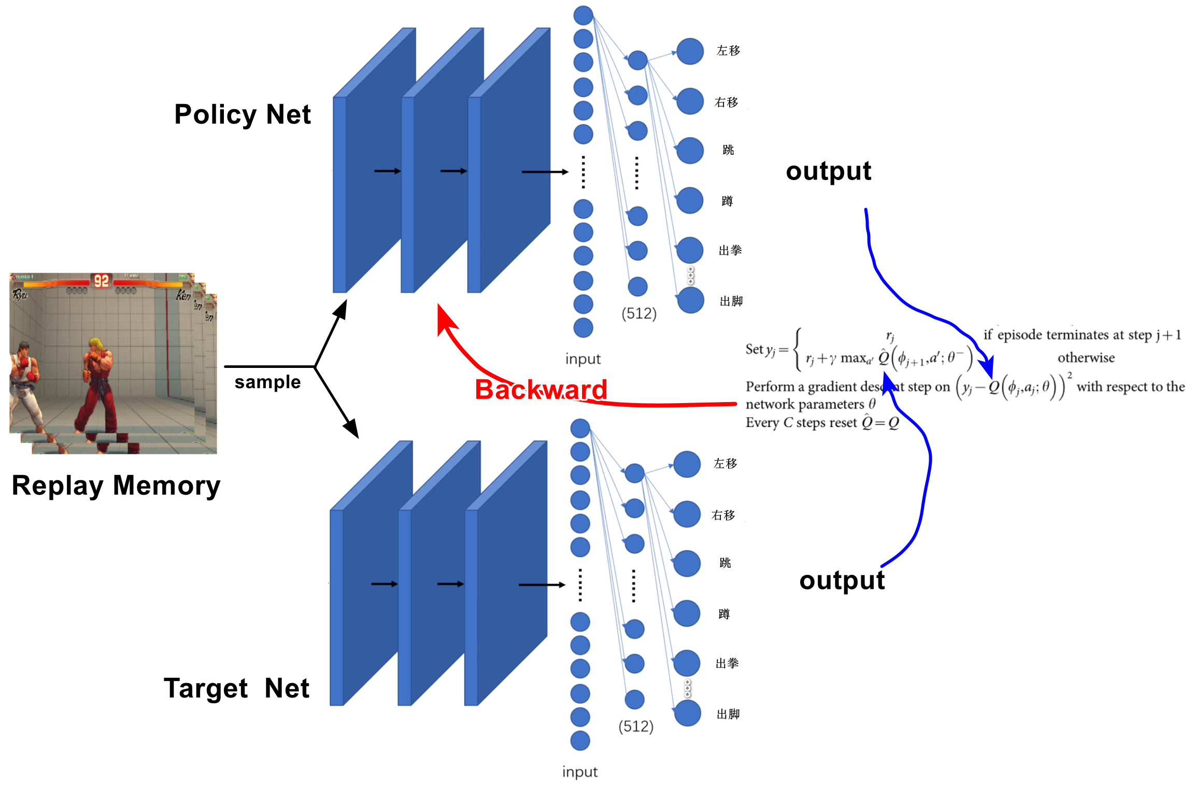
Training process
Ziming Li
SFIV with DQN
2022-5-20 4/23

Slide 7
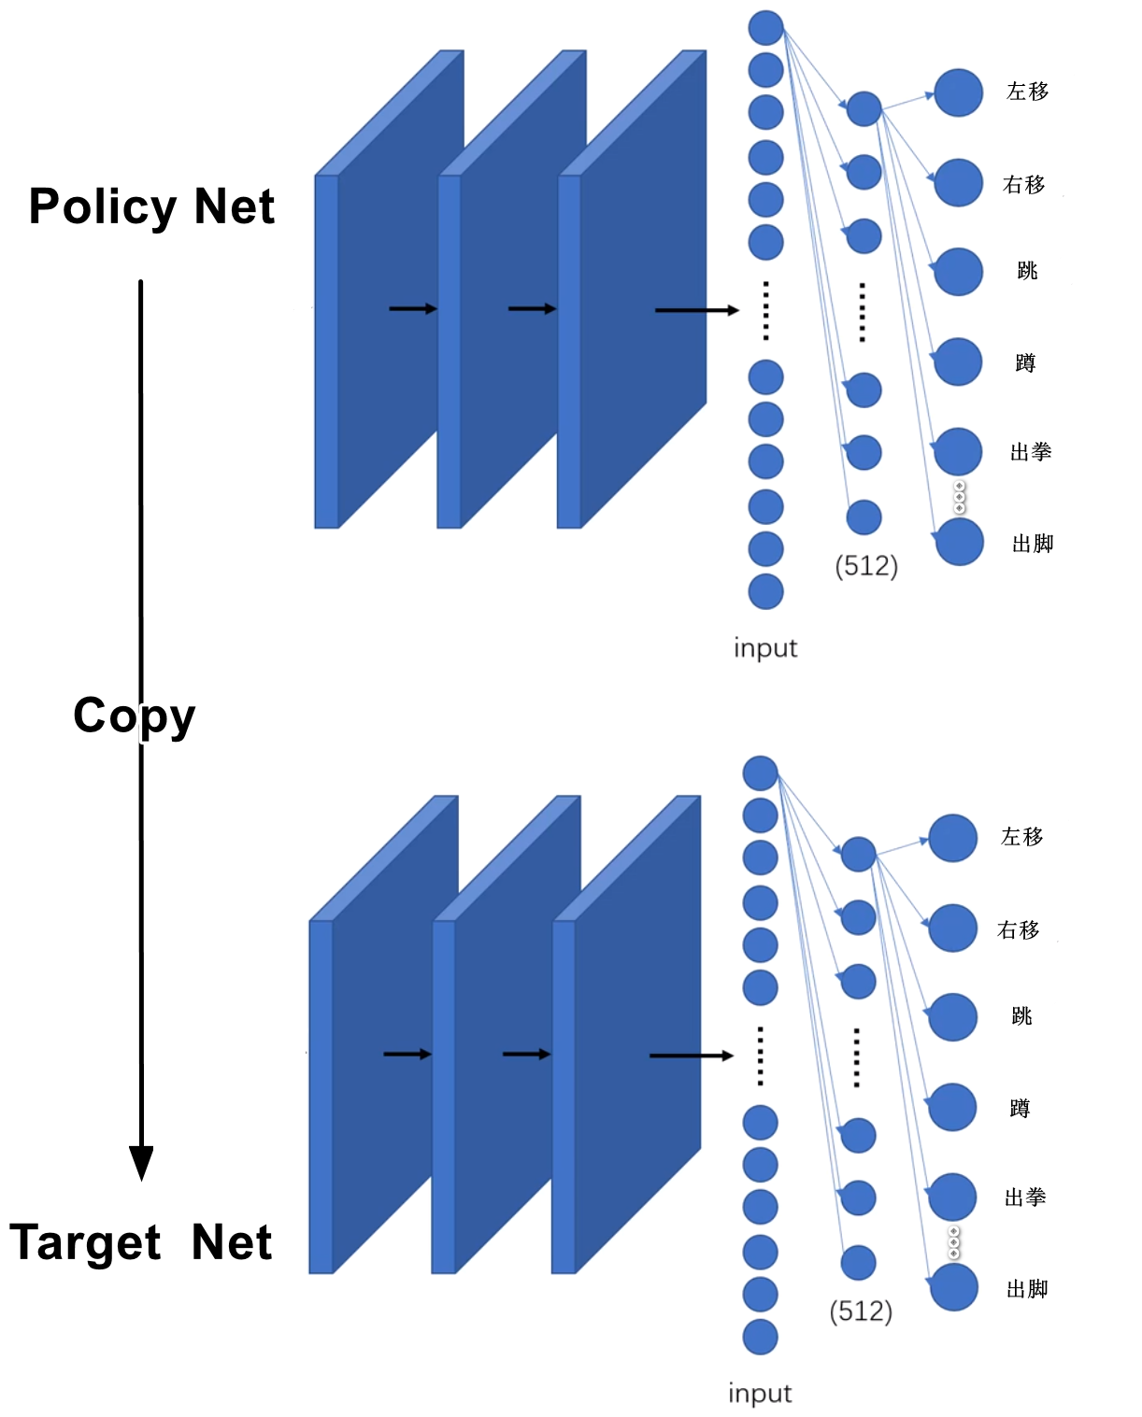
Training process
Ziming Li
SFIV with DQN
2022-5-20 5/23

Slide 8
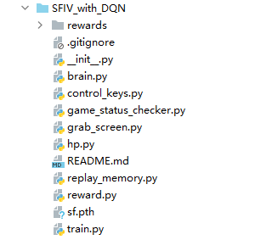
Project structure
Ziming Li
SFIV with DQN
2022-5-20 6/23

Slide 9
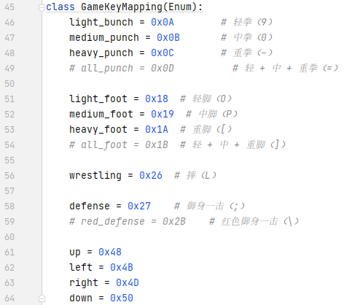
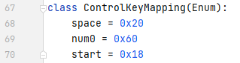
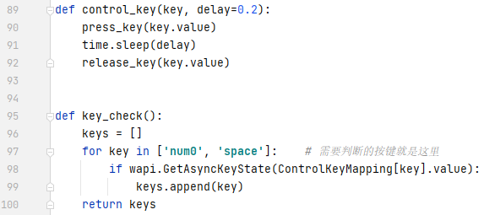
control_keys.py
Ziming Li
SFIV with DQN
2022-5-20 7/23

Slide 10
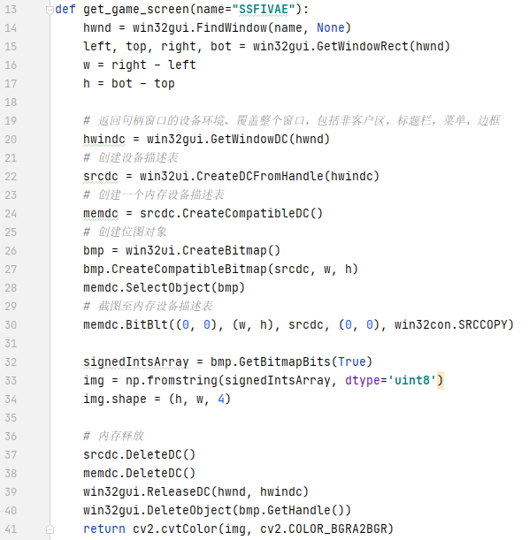
grad_screen.py
Ziming Li
SFIV with DQN
2022-5-20 8/23

Slide 11
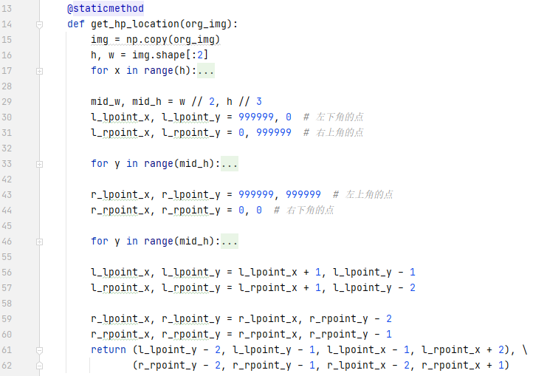
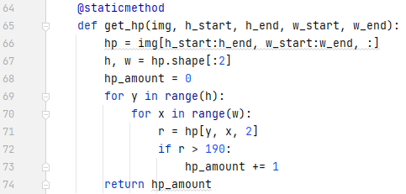
hp.py
Ziming Li
SFIV with DQN
2022-5-20 9/23

Slide 12
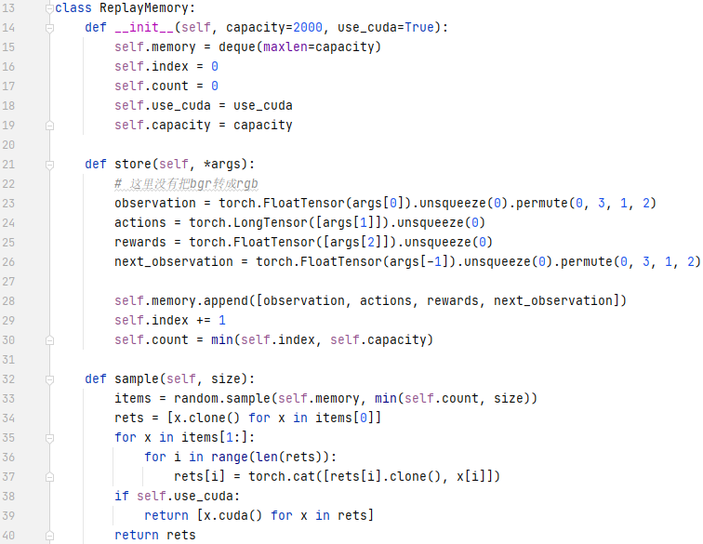
replay_memory.py
Ziming Li
SFIV with DQN
2022-5-20 10/23

Slide 13
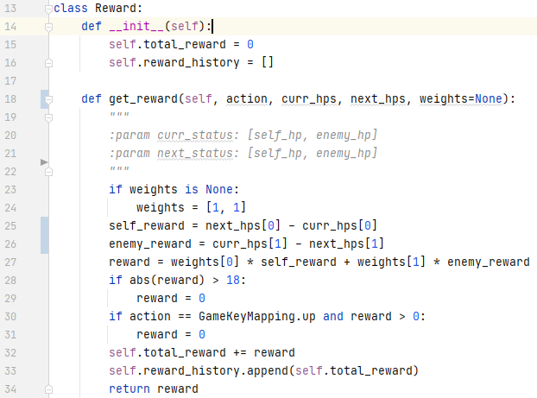
reward.py
Ziming Li
SFIV with DQN
2022-5-20 11/23

Slide 14
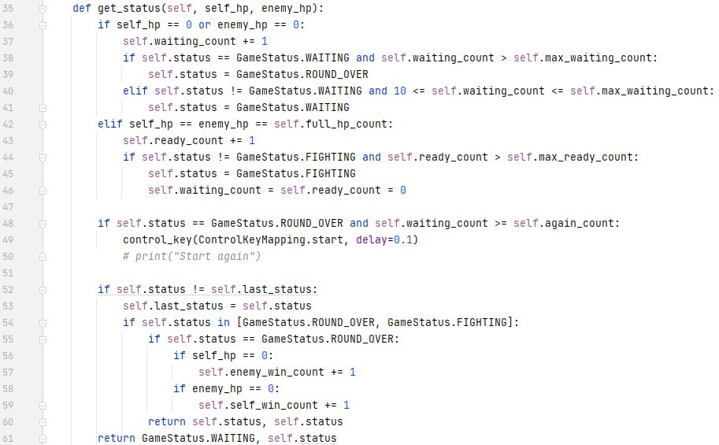
game_status_checker.py
Ziming Li
SFIV with DQN
2022-5-20 12/23

Slide 15
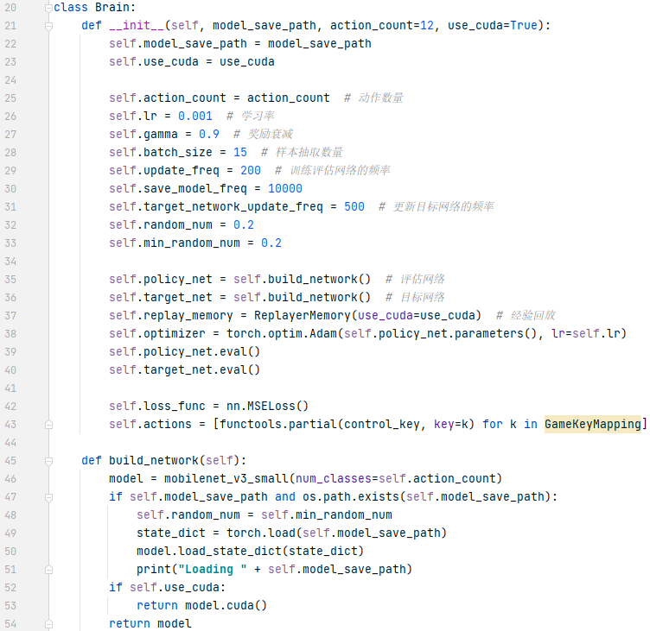
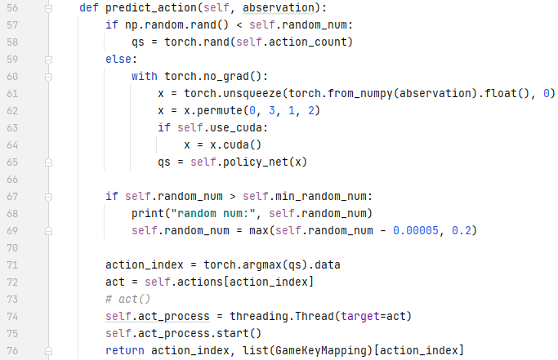
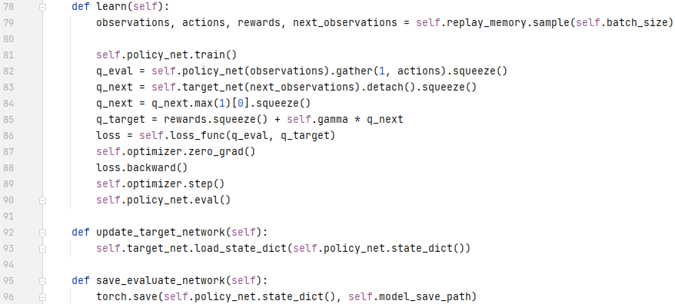
brain.py
Ziming Li
SFIV with DQN
2022-5-20 13/23

Slide 16
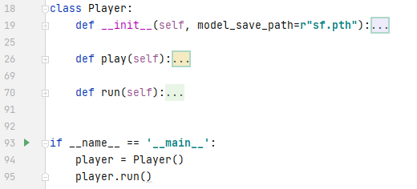
train.py
Ziming Li
SFIV with DQN
2022-5-20 14/23

Slide 17
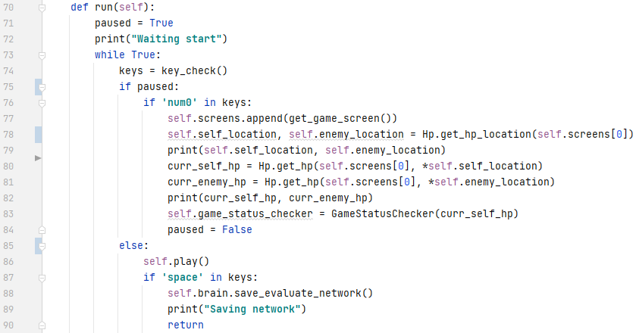
train.run
Ziming Li
SFIV with DQN
2022-5-20 15/23

Slide 18
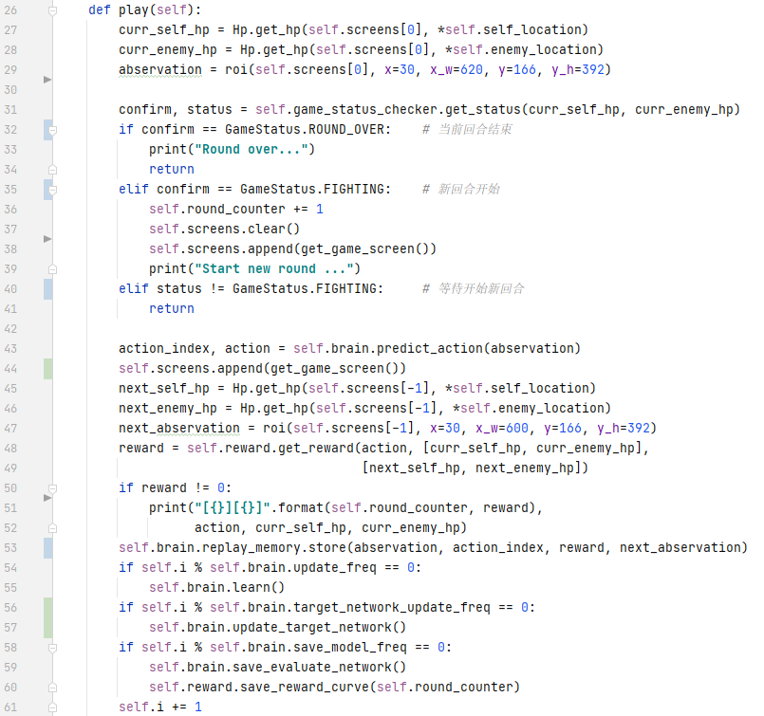
train.play
Ziming Li
SFIV with DQN
2022-5-20 16/23

Slide 19
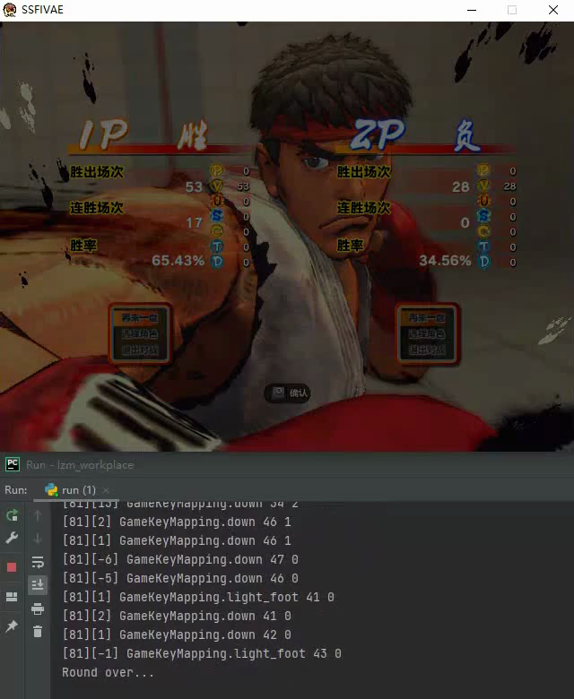
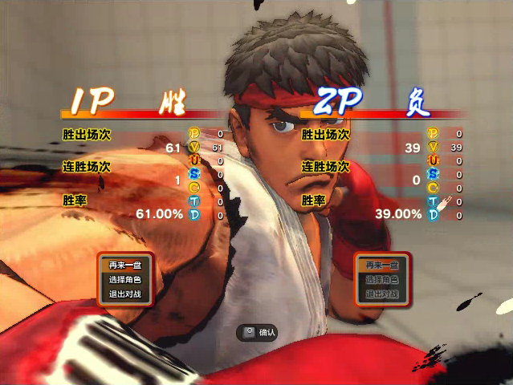
Training effect
Ziming Li
SFIV with DQN
2022-5-20 17/23

Slide 20
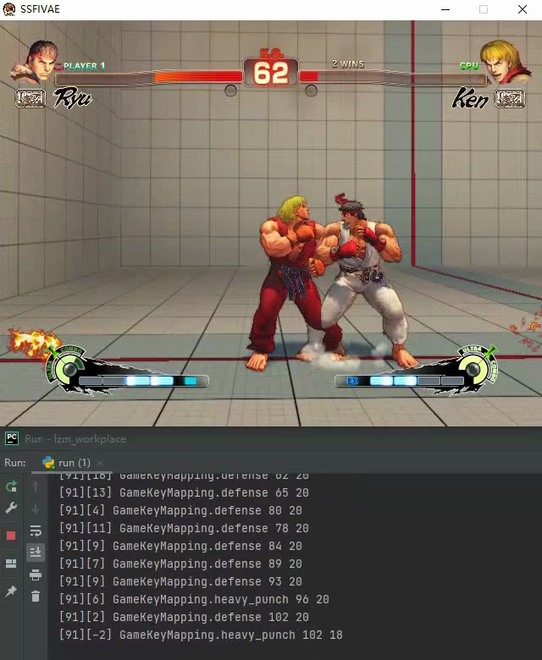
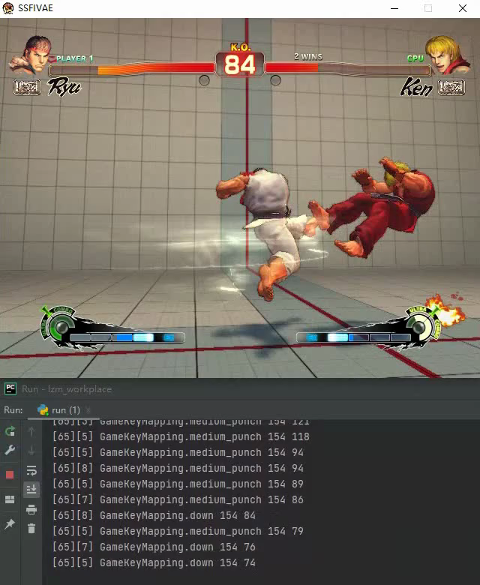
Abnormal condition
Ziming Li
SFIV with DQN
2022-5-20 18/23

Slide 21
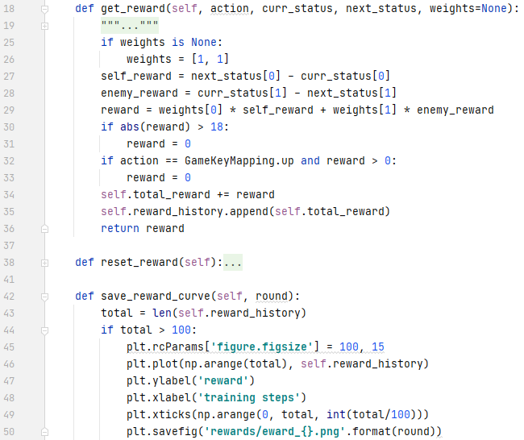
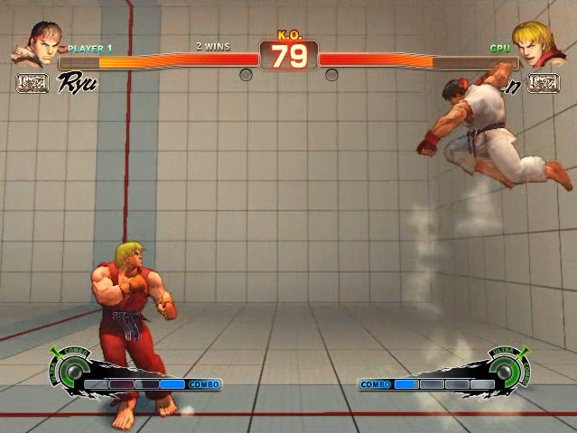
Abnormal condition
Ziming Li
SFIV with DQN
2022-5-20 19/23

Slide 22
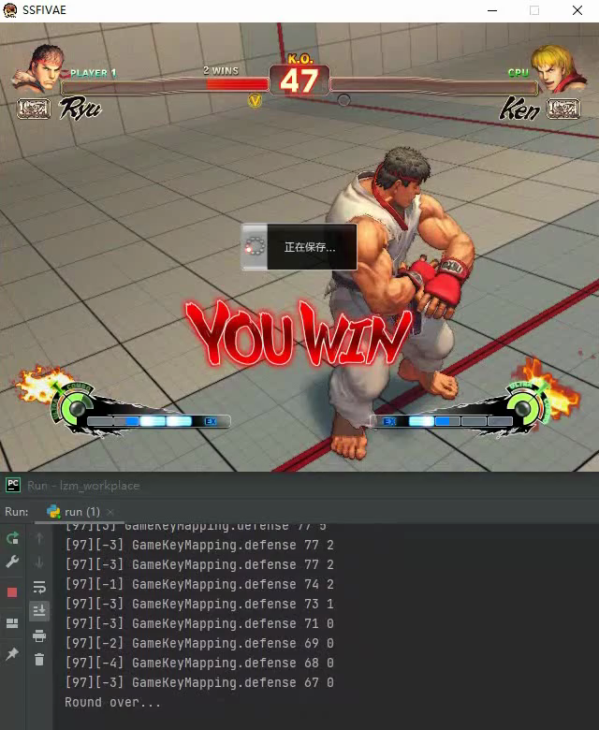
Final training effect
Ziming Li
SFIV with DQN
2022-5-20 20/23

Slide 23
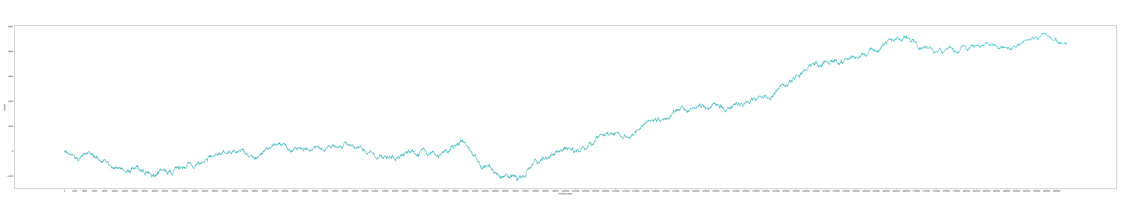
Reward curve
Ziming Li
SFIV with DQN
2022-5-20 21/23

Slide 24
1. 论文：https://www.nature.com/articles/nature14236
2. 论文代码：https://github.com/deepmind/dqn
3. 官方示例：https://pytorch.org/tutorials/intermediate/reinforcement_q_learning.html
4. pytorchvision：https://github.com/pytorch/vision
Ziming Li
SFIV with DQN
2022-5-20 22/23

Slide 25
Thanks
https://github.com/zi-ming/SFIV_with_DQN
Ziming Li
SFIV with DQN
2022-5-20 23/23

